Slide 1
Decision Trees and Ensembles
Topics in Applied Statistics
Spring 2014
Department of Statistics
Korea University

Slide 2
Decision Tree
A decision tree is a logical model represented as a tree that shows how the value of a target variable can be predicted by using the values of a set of predictor (input) variables.
A decision tree recursively partitions the data and sample space to construct the predictive model.
Its name derives from the practice of displaying the partitions as a decision tree, from which the roles of the predictor variables may be inferred.
A classification or regression tree is a prediction model that can be represented as a decision tree.
A tree-structured classifier is a decision tree for predicting a class variable from one or more predictor variables.
A regression tree model is a nonparametric estimate of a regression function constructed by recursively partitioning a data set with the values of its predictor variables.
Recursive partitioning methods have become popular and widely used tools for nonparametric regression and classification in many scientific fields.

Slide 3
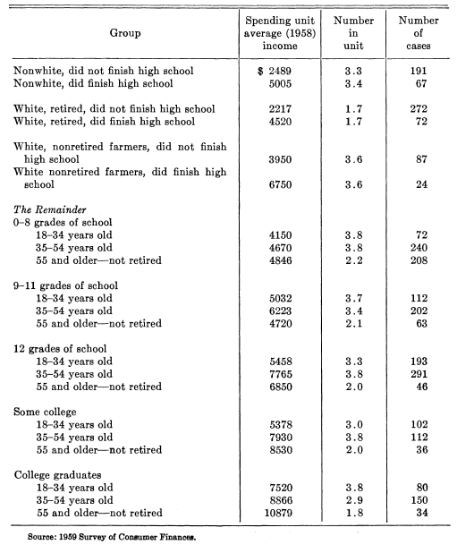
Motivating Example of Decision Tree
MORGAN, J. N. and SONQUIST, J. A. (1963). Problems in the analysis of survey data, and a proposal. J. Amer. Statist. Assoc. 58 415–434.

Slide 4
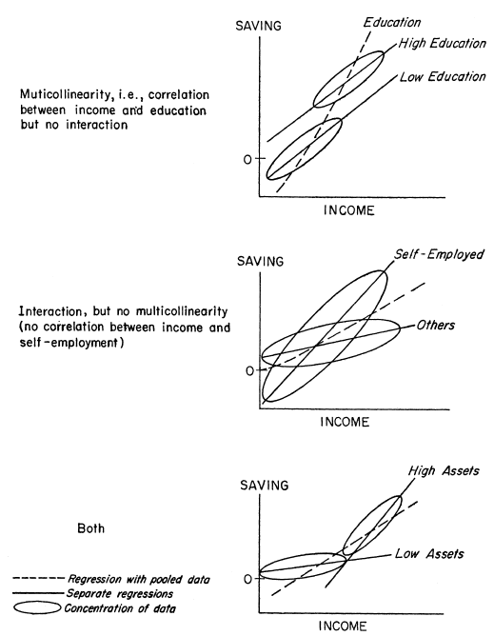
Motivating Example of Decision Tree
MORGAN, J. N. and SONQUIST, J. A. (1963). Problems in the analysis of survey data, and a proposal. J. Amer. Statist. Assoc. 58 415–434.

Slide 5
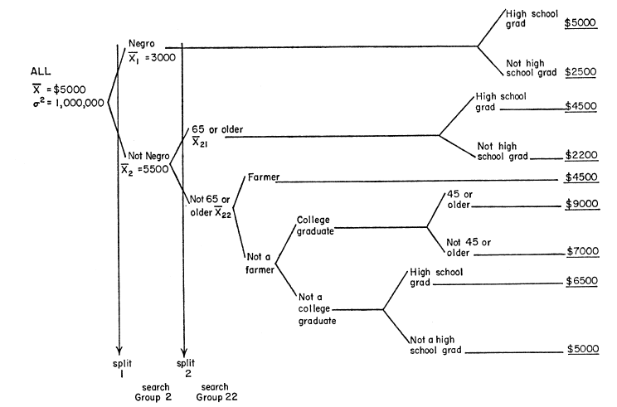
Motivating Example of Decision Tree
MORGAN, J. N. and SONQUIST, J. A. (1963). Problems in the analysis of survey data, and a proposal. J. Amer. Statist. Assoc. 58 415–434.

Slide 6
Elements of Decision Tree
An empirical tree represents a segmentation of the data that is created by applying a series of split rules. Each split rule assigns an observation to a segment based on the values of inputs.
One rule is applied after another, resulting in a hierarchy of segments within segments. The hierarchy is called a tree, and each segment is called a node.
The original segment contains the entire data set and is called the root node of the tree. A node with all its successors forms a branch of the node that created it.
The nodes that have child nodes are called interior (or internal, intermediate) nodes. The final nodes that do not have child nodes are called leaves (or terminal nodes). For each leaf, a decision is made and applied to all observations in the leaf.
The type of decision depends on the context. In predictive modeling, the decision is simply the predicted value.

Slide 7
Building and Utilizing a Decision Tree
Splitting recursively
  Partition the data and sample space recursively to construct a predictive model.
  Split selection: split variable selection and split set selection
Determining a tree size
  Partitioning continues until stopping criteria are met.
  (Stopping criteria: sample size, impurity, improvement, and so on)
  Partitioning continues until node sample sizes are too small, and then prune insignificant nodes that cause over-fitting.
Interpretation and Prediction
  Interpret the final predictive tree model with the significant split variables.
  Predict target values of new data using the final predictive tree model.

Slide 8
Split Rule Selection
Split rule: consisting of a split variable and a split point (or set).
  X ≤ c for ordered variable
  X∈A for unordered variable
Split rule: determined by examining all possible splits (exhaustive search) or performing statistical tests
Good split rule: the data being homogeneous within each subnode and heterogeneous between subnodes.

Slide 9
Tree Size Determination
Naïve stopping rule: Stop splitting if
  a node sample size is small,
  a node impurity is low,
  or an improvement is minor.
Pruning rule:
  Step 1: Stop splitting if a node sample size is small.
  Step 2: Prune off unnecessary branches.

Slide 10
Missing Values
Imputation approach
  Impute missing values with means for numerical variable or modes for categorical variables.
Surrogate split approach
  Find the next best splits as surrogates.
Separate category approach
  Treat missing values as separate values free of order.

Slide 11
Overview of Decision Tree: References
Loh, W.-Y. (2008). Regression by parts: Fitting visually interpretable models with GUIDE. In Handbook of Data Visualization, C. Chen, W. Härdle, and A. Unwin, Eds. Springer, pp. 447-469.
Loh, W.-Y. (2008). Classification and regression tree methods. In Encyclopedia of Statistics in Quality and Reliability, F. Ruggeri, R. Kenett, and F. W. Faltin, Eds. Wiley, Chichester, UK, pp. 315-323.
Loh, W.-Y. (2010). Tree-structured classifiers. Wiley Interdisciplinary Reviews: Computational Statistics, 2, 364-369.
Loh, W.-Y. (2011). Classification and regression trees. Wiley Interdisciplinary Reviews: Data Mining and Knowledge Discovery, 14-23.
Loh, W.-Y. (2013). Fifty years of classification and regression trees. International Statistical Review., In press.
Merkle, E.C. and Shaffer, V.A. (2011). Binary recursive partitioning: Background, methods, and application to psychology, British Journal of Mathematical and Statistical Psychology, 64, 161–181.
Morgan, J. N. and Sonquist, J. A. (1963). Problems in the analysis of survey data, and a proposal. J. Amer. Statist. Assoc. 58 415–434.
Strobl, C., Malley, J. and Tutz, G. (2009). An Introduction to Recursive Partitioning: Rationale, Application, and Characteristics of Classification and Regression Trees, Bagging, and Random forests. Psychological Methods, 14(4), 323–348.

Slide 12
Major Decision Trees
CHAID
  Originally, from AID developed by Morgan and Sonquist (1963)
  Developed by Kass (1980)
CART
  Developed by Breiman, Friedman, Olsen, and Stone (1984)
C4.5/C5.0
  Developed by Quinlan (1993)
PARTY
  Developed by Hothorn, Hornik, and Zeileis (2006)
GUIDE
  Originally, from FACT developed by Loh and Vanichsetakul (1988)
  Developed by Loh (2002, 2009)

Slide 13
CHAID: Overview
CHAID stands for Chi-squared Automatic Interaction Detector. It is the first approach based on statistical significance tests for contingency tables.
Developed by Kass (1980)
Split rule selection
  Split selection by Chi-square test (nominal targets) or F-test (interval targets).
Tree size determination
  Stop if no merge or re-splitting operation creates an adequate p-value.
Missing value
  Separate values

Slide 14
CHAID: Algorithm
CHAID finds the best partition for each predictor and then compare the predictors and choose the best one. Roughly, the algorithm works as follows:
For each predictor, cross-tabulate the categories of the predictor with the categories of the dependent variable and do (2) and (3).
Merge least significant categories.
Find the most significant binary split.
Calculate the significance of each optimally merged predictor, and isolate the most significant predictor. If this significance is greater than a critical value, split the data according to the (merged) categories of the selected predictor.
Repeat this procedure until a node sample is small.

Slide 15
CHAID vs SAS E-Miner
The SAS Tree seeks the split minimizing the adjusted p-value, whereas the original CHAID algorithm of Kass (1980) does not.
The CHAID exhaustive method is similar to the SAS Tree heuristic method, except the exhaustive method "re-splits" and the Tree node "reassigns".
CHAID software discretizes interval inputs, while SAS Tree sometimes consolidates observations into groups.
SAS Tree searches on a within-node sample, unlike CHAID.

Slide 16
CHAID: References
Morgan, J. N. and Messenger, R. C. (1973). THAID: A sequential analysis program for the analysis of nominal scale dependent variables. Technical report, Institute for Social Research, Univ. Michigan, Ann Arbor.
Morgan, J. N. and Sonquist, J. A. (1963). Problems in the analysis of survey data, and a proposal. J. Amer. Statist. Assoc. 58 415–434.
Fielding, A. (1977). Binary segmentation: The automatic detector and related techniques for exploring data structure. In C. A. O’Muircheartaigh and C. Payne, editors, The Analysis of Survey Data, Volume I, Exploring Data Structures. Wiley, New York.
Kass, G. (1980), “An Exploratory Technique for Investigating Large Quantities of Categorical Data,” Applied Statistics, 29, 119–127.
Magidson, J. (1994). The CHAID approach to segmentation modeling: chi-squared automatic interaction detection, in Bagozzi, Richard P. (ed); Advanced Methods of Marketing Research, Blackwell, Oxford, GB, pp. 118–159.

Slide 17
CART: Overview
CART stands for Classification And Regression Tree, and is a registered trademark of California Statistical Software.
Developed by Breiman et al. (1984).
The commercial software for CART is sold by Salford Systems(http://www.salford-systems.com/products/cart).
R version for CART is rpart.
Split rule selection
  Split selection by exhaustive search
    For interval targets, reduction in variance
    For nominal targets, Gini impurity
Tree size determination
  Cost-complexity pruning
Missing value
  Surrogate splits

Slide 18
CART: Algorithm
CART finds the best splits by examining all possible splits (exhaustive search) and determine a optimal tree size by pruning off insignificant nodes (cost-complexity pruning). Roughly, the algorithm works as follows:
(1) Find the split rule with maximum worth.
- For interval targets, find the split with maximum variance reduction:
Maximizing ∆(t) = i(t)-[i(t_{L})+i(t_{R})],
where impurity i (t) = ∑_{i}(Y_{i}-Ŷ)², for node t and its subnodes t_{L} and t
- For non-interval targets, find the split with maximum Gini index:
Maximizing ∆(t) = i(t)-[P_{L}i(t_{L})+P_{R}i(t_{R})],
where impurity i (t) = 1-[(Pr(class 1))²+(Pr(class 2))²+…] , for node t and its subnodes t_{L} and t_{R}
(2) Repeat (1) recursively until each node has the minimum number of observations.
(3) Prune off least significant branches to have a series of subtrees:
T_{max} < T₁ < T₂ <…< T_{root}
(4) Evaluate the subtrees by independent test samples or cross-validation(CV), and then selected the best tree.

Slide 19
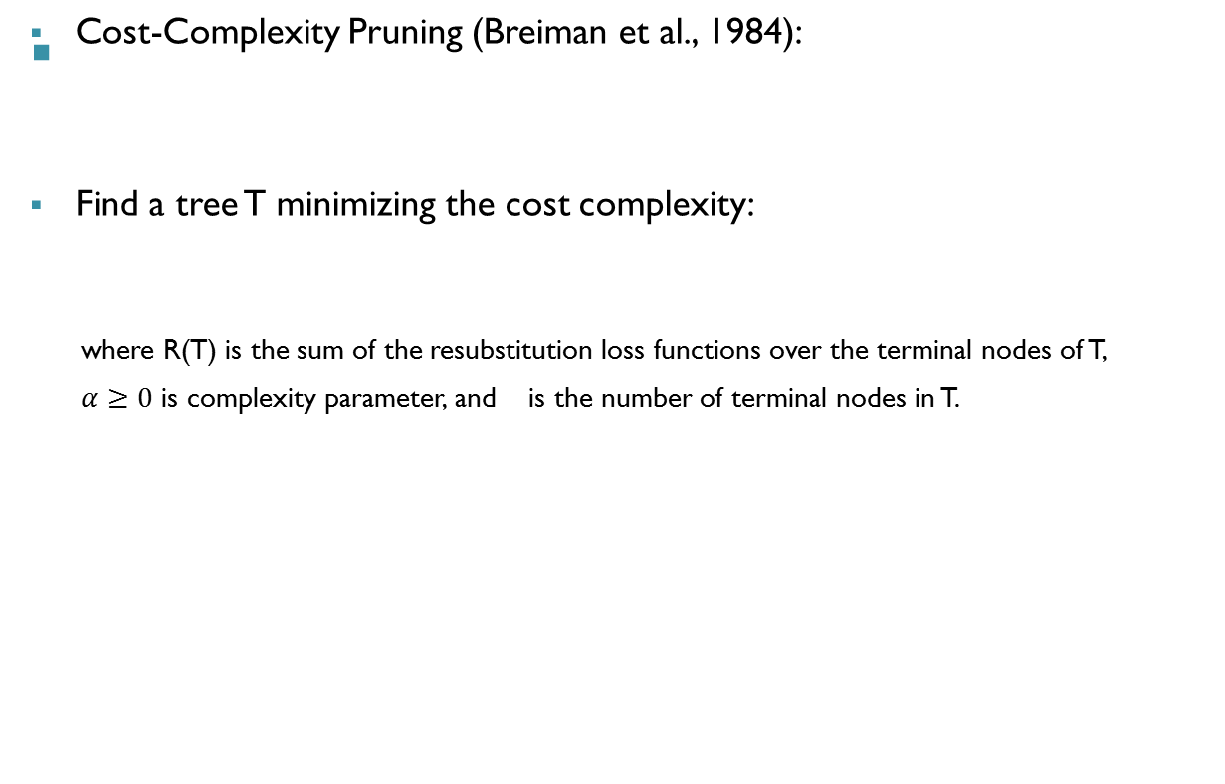
CART: Algorithm

Slide 20
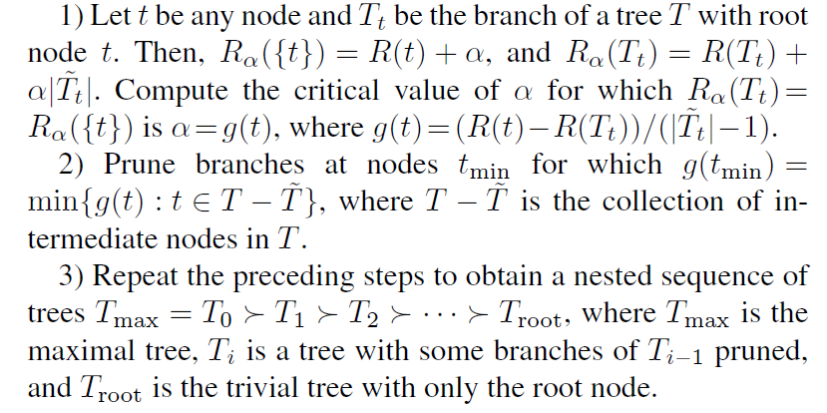
CART: Algorithm
Step 1 of Cost-Complexity Pruning: Obtain candidate trees

Slide 21
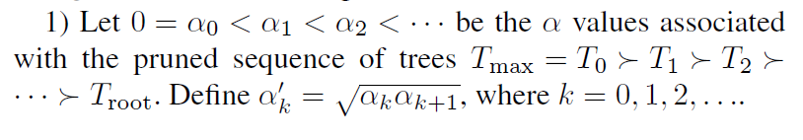
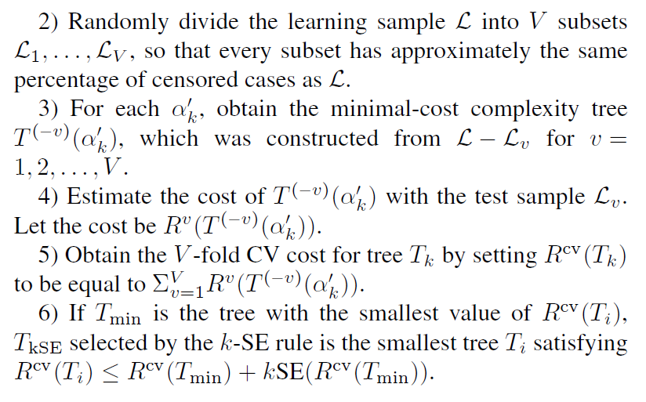
CART: Algorithm
Step 2 of Cost-Complexity Pruning: Select an optimal tree

Slide 22
CART: References
L. Breiman, J. H. Friedman, R. A. Olshen, and C. J. Stone (1984). Classification and Regression Trees. Wadsworth, Belmont.
T. M. Therneau and E. J. Atkinson (1997). An introduction to recursive partitioning using the RPART routine. Technical Report 61, Mayo Clinic, Section of Statistics.

Slide 23
C4.5: Overview
C4.5 is a classification tree algorithm, and an extension of Quinlan's earlier ID3 algorithm.
Developed by Quinlan (1993)
Obtain the J48 implementation in WEKA (Witten and Frank, 2005). (http://www.cs.waikato.ac.nz/ml/weka).
Split rule selection
  Split selection by exhaustive search with Entropy index
  Binary splits for interval inputs and multi-way splits for non-interval inputs
Tree size determination
  Pessimistic pruning
Missing value
  Not used in gain and entropy calculations

Slide 24
C4.5: Algorithm
C4.5 is a classification tree algorithm. If the split variable is non-categorical, the node is divided into two. If it is categorical, the node splits into m branches, with one branch for each categorical value. Roughly, the algorithm works as follows:
(1) Select the split with the highest gain ratio.
  Entropy e(t) = −∑_{j} p(j|t) log{p(j|t)} at node t
  Gain = e(t) −∑_{i} e(t_{i})N(t_{i})/N(t).
  Gain ratio = Gain/ ∑_{i}N(t_{i}){log N(t_{i}) − log N(t)}/N(t)
(2) Repeat (1) recursively until each node has the minimum number of observations.
(3) Grow a large tree and then prunes it back to a smaller size, using a conservative estimate of the error at each node to prune. (Quinlan, 1993, pp37-42)

Slide 25
C4.5 vs C5.0
Essentially, C5.0 is C4.5 with the following differences:
  The branch-merging option for nominal splits is the default.
  You may specify misclassification costs.
  Boosting and cross-validation are available.
  The algorithm for creating rule sets from trees is much improved.

Slide 26
C4.5/C5.0 : References
Quinlan, J. R. (1986). Induction of Decision Trees. Mach. Learn. 1, 1 (Mar. 1986), 81-106.
Quinlan , J. R. (1992). Learning with continuous classes. In Proceedings of the Australian Joint Conference on Artificial Intelligence, pages 343–348, Singapore, 1992. World Scientific.
Quinlan, J. R (1993). C4.5: Programs for Machine Learning. Morgan Kaufmann Publishers.
Quinlan, J. R. (1996). Improved use of continuous attributes in c4.5. Journal of Artificial Intelligence Research, 4:77-90.
Witten, I. and Frank, E. (2005). Data Mining: Practical Machine Learning Tools and Techniques with JAVA Implementations. Morgan Kaufmann, San Fransico, CA, second edition. http://www.cs.waikato.ac.nz/ml/weka.

Slide 27
PARTY: Overview
Recursive partitioning for continuous, censored, ordered, nominal and multivariate response variables in a conditional inference framework
Conditional inference trees (ctree) in R package party
Developed by Hothorn, Hornik, and Zeileis (2006)
Information available at
  http://cran.r-project.org/web/packages/party/index.html
Split rule selection
  Unbiased variable selection by permutation tests
  Split set selection by exhaustive permutation tests
Tree size determination
  Stop if insignificant
  No pruning
Missing value
  Surrogate split

Slide 28
PARTY: Algorithm
Conditional inference trees (ctree) estimate a regression relationship by binary recursive partitioning in a conditional inference framework. Roughly, the algorithm works as follows:
(1) Test the global null hypothesis of independence between any of the input variables and the response (which may be multivariate as well).
  Stop if this hypothesis cannot be rejected.
  Otherwise select the input variable with strongest association to the response.
  This association is measured by a p-value corresponding to a test for the partial null hypothesis of a single input variable and the response.
(2) Implement a binary split in the selected input variable.
(3) Recursively repeat steps (1) and (2).

Slide 29
PARTY: References
Helmut Strasser and Christian Weber (1999). On the asymptotic theory of permutation statistics. Mathematical Methods of Statistics, 8, 220–250.
Torsten Hothorn, Kurt Hornik, Mark A. van de Wiel and Achim Zeileis (2006). A Lego System for Conditional Inference. The American Statistician, 60(3), 257–263.
Torsten Hothorn, Kurt Hornik and Achim Zeileis (2006). Unbiased Recursive Partitioning: A Conditional Inference Framework. Journal of Computational and Graphical Statistics, 15(3), 651–674.
Carolin Strobl, James Malley and Gerhard Tutz (2009). An Introduction to Recursive Partitioning: Rationale, Application, and Characteristics of Classification and Regression Trees, Bagging, and Random forests. Psychological Methods, 14(4), 323–348.

Slide 30
GUIDE: Overview
Multi-purpose machine learning algorithm for constructing classification and regression trees
FOTRAN compiled binaries guide for Windows, Linux, and Mac OS
Developed by Loh (2002, 2009)
Information available at http://pages.stat.wisc.edu/~loh/
Split rule selection
  Unbiased variable selection by main-effect and interaction tests
  Split set selection by special methods
Tree size determination
  Cost-complexity pruning with CV or independent test sample
Missing value
  Imputation (mean or mode)

Slide 31
GUIDE: Algorithm
GUIDE is a multi-purpose machine learning algorithm for constructing classification and regression trees. Roughly, the algorithm works as follows:
(1) Select the split variable(s) by main-effect and interaction tests, and then select a split set by a special method for the selected variable.
(2) Recursively repeat step (1) until each node is pure or has a small sample size.
(3) Determine a tree size by cost-complexity pruning.

Slide 32
GUIDE vs QUEST vs CRUISE
QUEST (Loh and Shih, 1997)
  ANOVA F-tests for non-categorical variables
  Chi-squared test for categorical variables
CRUISE (Kim and Loh, 2001)
  Multi-way splits
  Include interactions between pairs of variables
  Fit linear discriminant models in each node
GUIDE
  Piecewise-constant, multiple linear, simple polynomial
  Least-squares, quantile, Poisson, and proportional hazards regression

Slide 33
GUIDE: References
Loh, W.-Y. (2013), Fifty years of classification and regression trees, International Statistical Review, in press.
Loh, W.-Y. and Zheng, W. (2013), Regression trees for longitudinal and multiresponse data, Annals of Applied Statistics, vol. 7, 496-522.
Loh, W.-Y. (2012), Variable selection for classification and regression in large p, small n problems, Lecture Notes in Statistics---Proceedings, A. Barbour, H.P. Chan and D. Siegmund (Eds.), vol 205, Springer, pp 133--157.
Loh, W.-Y. (2011), Classification and regression trees, Wiley Interdisciplinary Reviews: Data Mining and Knowledge Discovery, vol.1, 14-23.
Loh, W.-Y. (2010), Tree-structured classifiers, Wiley Interdisciplinary Reviews: Computational Statistics, vol.2, 364-369.
Loh, W.-Y. (2009), Improving the precision of classification trees. Annals of Applied Statistics, vol. 3, 1710-1737. [The definitive reference for GUIDE classification.]
Loh, W.-Y. (2008), Classification and regression tree methods. Encyclopedia of Statistics in Quality and Reliability, F. Ruggeri, R. Kenett, and F. W. Faltin (Eds.) Wiley, pp. 315-323.
Loh, W.-Y. (2008), Regression by parts: Fitting visually interpretable models with GUIDE, Handbook of Computational Statistics, vol. III , 447-469, Springer.
Loh, W.-Y., Chen, C.-W., and Zheng, W.(2007), Extrapolation errors in linear model trees. ACM Transactions on Knowledge Discovery in Data, vol. 1, issue 2, article 6.
Kim, H., Loh, W.-Y., Shih, Y.-S., and Chaudhuri, P. (2007), Visualizable and interpretable regression models with good prediction power . IIE Transactions, vol. 39, Issue 6, June 2007, pp. 565-579.
Loh, W.-Y. (2006), Regression tree models for designed experiments, Second Lehmann Symposium, Institute of Mathematical Statistics Lecture Notes-Monograph Series, vol. 49, 210-228.
Loh, W.-Y. (2002), Regression trees with unbiased variable selection and interaction detection, Statistica Sinica, vol. 12, 361-386. [The definitive reference for GUIDE regression.]
Chaudhuri, P. and Loh, W.-Y. (2002), Nonparametric estimation of conditional quantiles using quantile regression trees, Bernoulli, vol. 8, 561-576.
Chaudhuri, P., Lo, W.-D., Loh, W.-Y., and Yang, C.-C. (1995), Generalized regression trees, Statistica Sinica, vol. 5, 641-666.
Chaudhuri, P., Huang, M.-C., Loh, W.-Y., and Yao, R. (1994), Piecewise-polynomial regression trees, Statistica Sinica, vol. 4, 143-167.
Loh, W.-Y., and Vanichsetakul, N. (1988), Tree-structured classification via generalized discriminant analysis (with discussion), Journal of the American Statistical Association, vol. 83, 715-728. [This the article that started it all.]

Slide 34
QUEST/CRUISE: References
Loh, W-Y. and Shih, Y.-S. (1997). Split selection methods for classification trees. Statistica Sinica, 7:815–840.
Kim, H. and Loh, W.-Y. (2001). Classification trees with unbiased multiway splits. Journal of the American Statistical Association, 96:589–604.
Kim, H., Loh, W.-Y., Shih, Y.-S., and Chaudhuri, P. (2007). A visualizable and interpretable regression model with good prediction power. IIE Transactions. Special Issue on Data Mining and Web Mining.
Kim, H. and Loh, W.-Y. (2003). Classification trees with bivariate linear discriminant node models. Journal of Computational and Graphical Statistics, 12:512–530.

Slide 35
Comparison

Slide 36
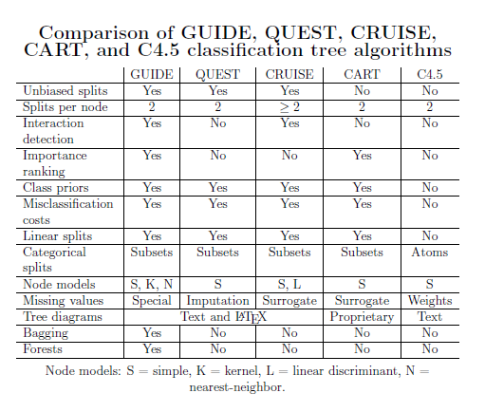
Comparison: Classification Trees
Loh, W.-Y. (2009), Improving the precision of classification trees. Annals of Applied Statistics, vol. 3, 1710-1737.

Slide 37
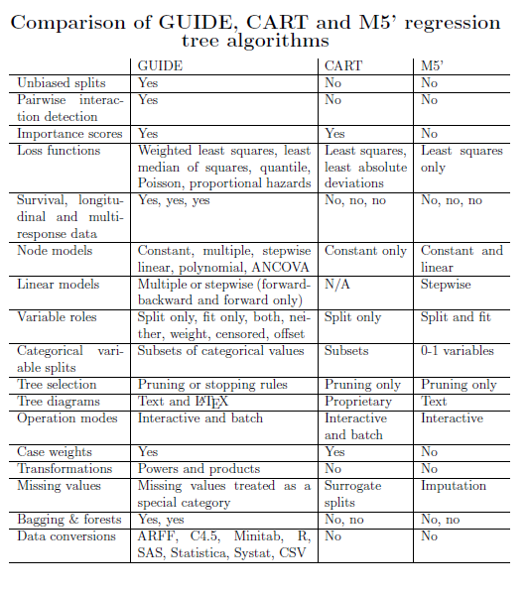
Comparison: Regression Trees
Loh, W.-Y. (2009), Improving the precision of classification trees. Annals of Applied Statistics, vol. 3, 1710-1737.

Slide 38
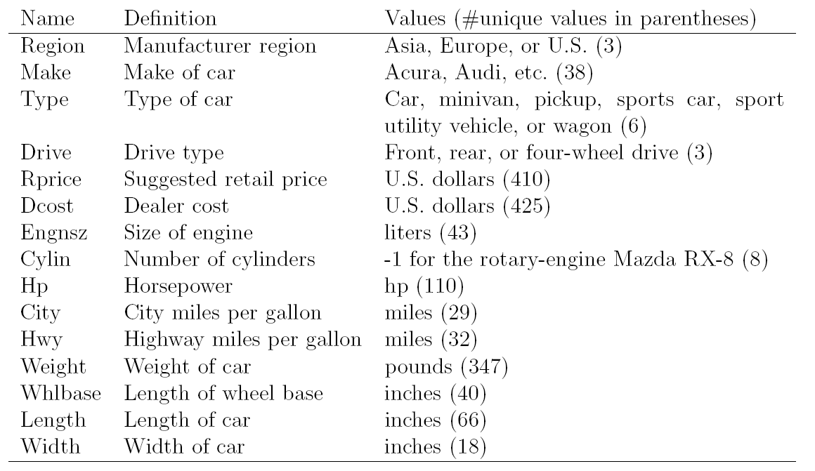
Example: Dataset on New Cars (Loh, 2008)
*Dataset on new cars for the 2004 model year from the Journal of Statistical Education Data Archive.

Slide 39
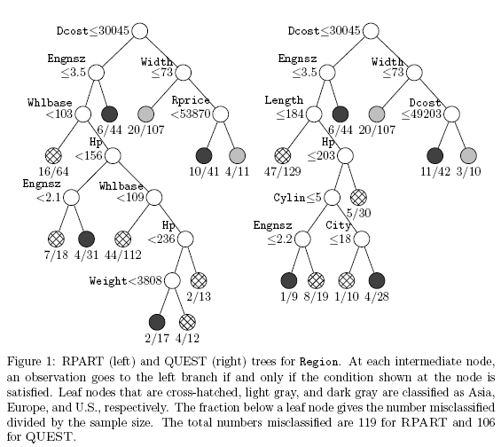

Slide 40
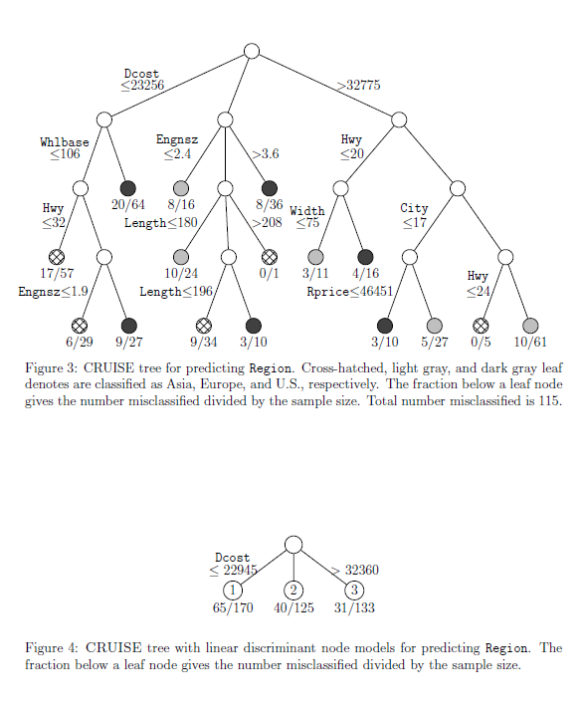

Slide 41
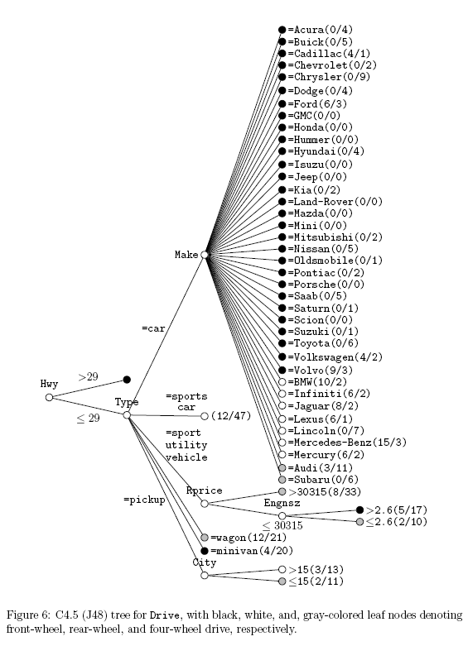

Slide 42
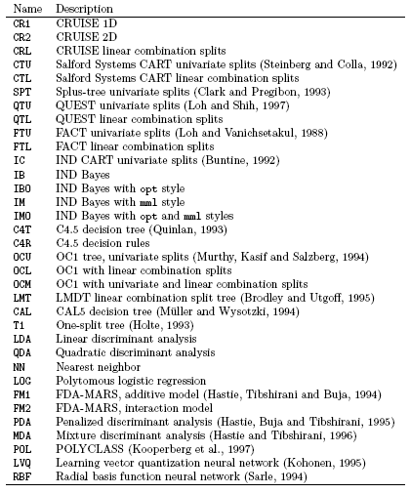
Example: Comparative Study
(Kim and Loh, 2001)

Slide 43
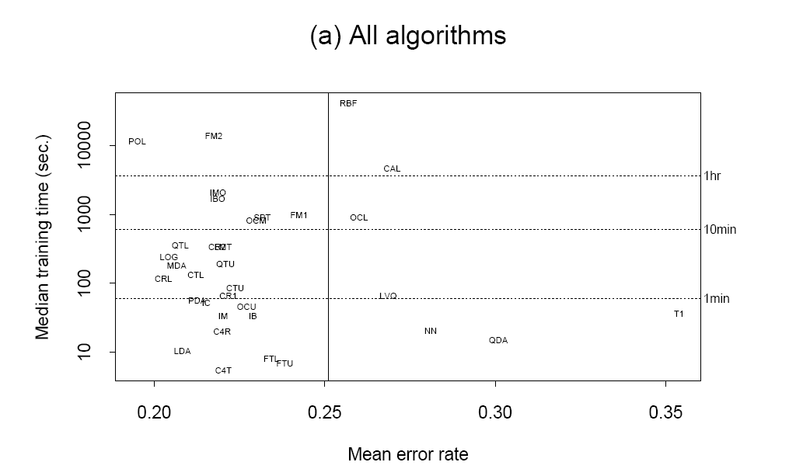

Slide 44
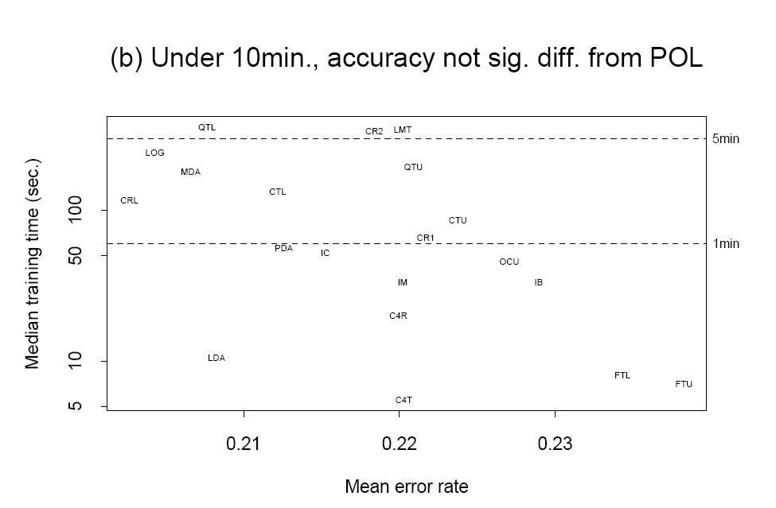

Slide 45
Comparison: References
Loh, W.-Y. (2009), Improving the precision of classification trees. Annals of Applied Statistics, vol. 3, 1710-1737.
Loh, W.-Y. (2008), Classification and regression tree methods. Encyclopedia of Statistics in Quality and Reliability, F. Ruggeri, R. Kenett, and F. W. Faltin (Eds.) Wiley, pp. 315-323.
Lim, T.-S. , Loh, W.-Y. , and Shih, Y.-S. (2000). A comparison of prediction accuracy, complexity, and training time of thirty-three old and new classification algorithms. Machine Learning, 40:203–228.

Slide 46
Improving Prediction Accuracy and Stability

Slide 47
Bagging
Bootstrap aggregating (bagging) is a meta-algorithm to improve machine learning of classification and regression models in terms of stability and classification accuracy.
It also reduces variance and helps to avoid overfitting.
Although it is usually applied to decision tree models, it can be used with any type of model.
It was first proposed by Breiman (1996).

Slide 48
Bagging Procedure
Let a learning set £ = {(y_{i}, x_{i}), i=1,…,n}, where the y’s are either class labels or a numerical response
Let h(x_{n}, £) = a predictor formed by £
Take repeated bootstrap samples {£^{(b)}} from £
Form {h(x_{n}, £^{(b)}), b=1,2,…,B}
If y is numerical, take an average of {h(x_{n}, £^{(b)}), b=1,2,…,B}.
If y is a class label, take a vote on {h(x_{n}, £^{(b)}), b=1,2,…,B}.

Slide 49
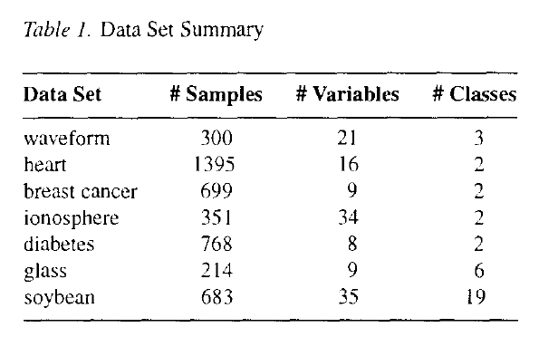
Experiments for Bagging (Breiman, 1996)

Slide 50
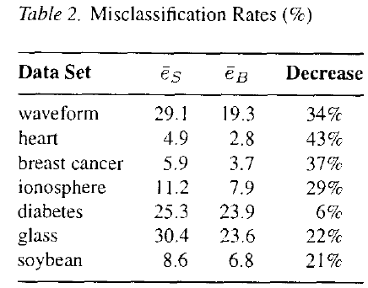
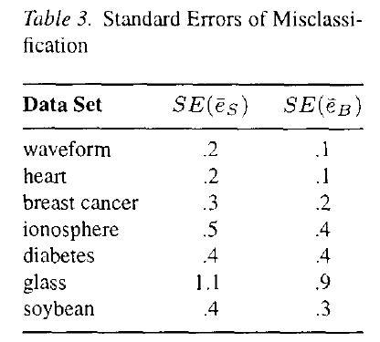
Experiments for Bagging (Breiman, 1996)

Slide 51
Boosting
Boosting is a machine learning meta-algorithm for performing supervised learning.
Boosting is based on the question posed by Kearns in 1988:
Can a set of weak learners create a single strong learner ?
A weak learner is defined to be a classifier which is only slightly correlated with the true classification.
A strong learner is a classifier that is arbitrarily well-correlated with the true classification.
AdaBoost (Freund and Schapire, 1996) is very popular and perhaps the most significant historically. However, there are many more recent algorithms such as LPBoost, TotalBoost, BrownBoost,MadaBoost, LogitBoost, and others.

Slide 52
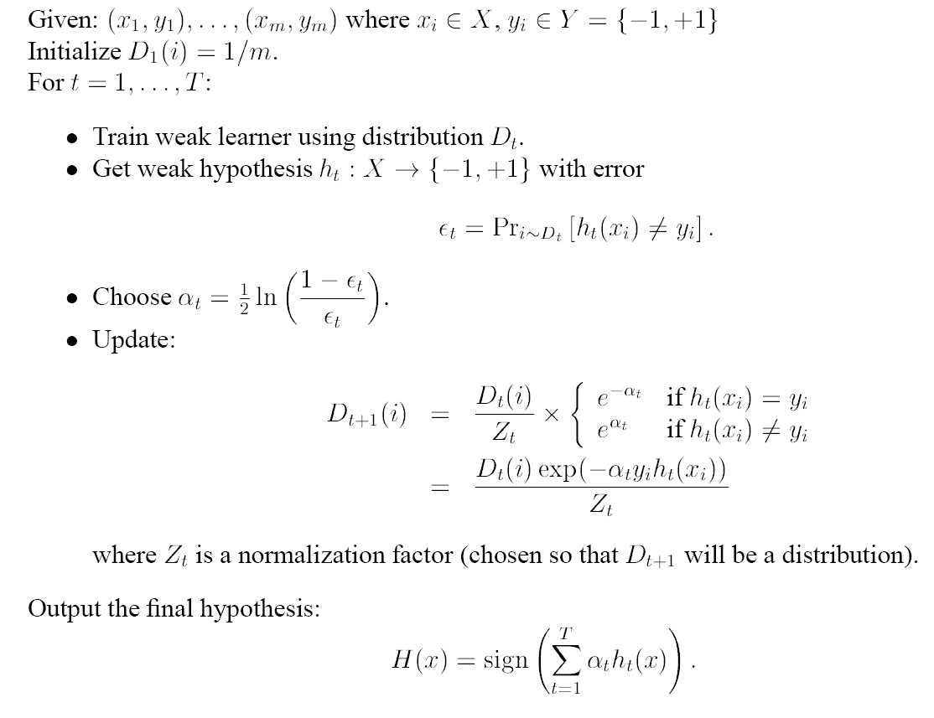

AdaBoost (Freund and Schapire, 1996)

Slide 53
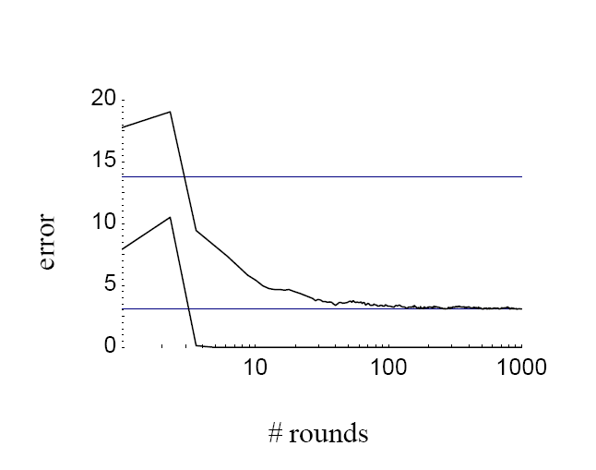
Experiment for AdaBoost
(Freund and Schapire, 1999)
Training set
Test set
Error curves for boosting C4.5 on the letter dataset

Slide 54
Random Forests
A random forest is a classifier that consists of many decision trees and outputs the class that is the mode of the classes output by individual trees.
The algorithm for inducing a random forest was developed by Leo Breiman and Adele Cutler, and Random Forests is their trademark.
The term came from random decision forests that was first proposed by Tin Kam Ho of Bell Labs in 1995.
The method combines Breiman's bagging idea and Ho's random subspace method to construct a collection of decision trees with controlled variations.

Slide 55
Algorithm for Random Forests
Each tree is constructed using the following algorithm:
  Let the number of training cases be N, and the number of variables in the classifier be M.
  We are told the number m of input variables to be used to determine the decision at a node of the tree; m should be much less than M.
  Choose a training set for this tree by choosing N times with replacement from all N available training cases (i.e. take a bootstrap sample). Use the rest of the cases to estimate the error of the tree, by predicting their classes.
  For each node of the tree, randomly choose m variables on which to base the decision at that node. Calculate the best split based on these m variables in the training set.
  Each tree is fully grown and not pruned (as may be done in constructing a normal tree classifier).

Slide 56
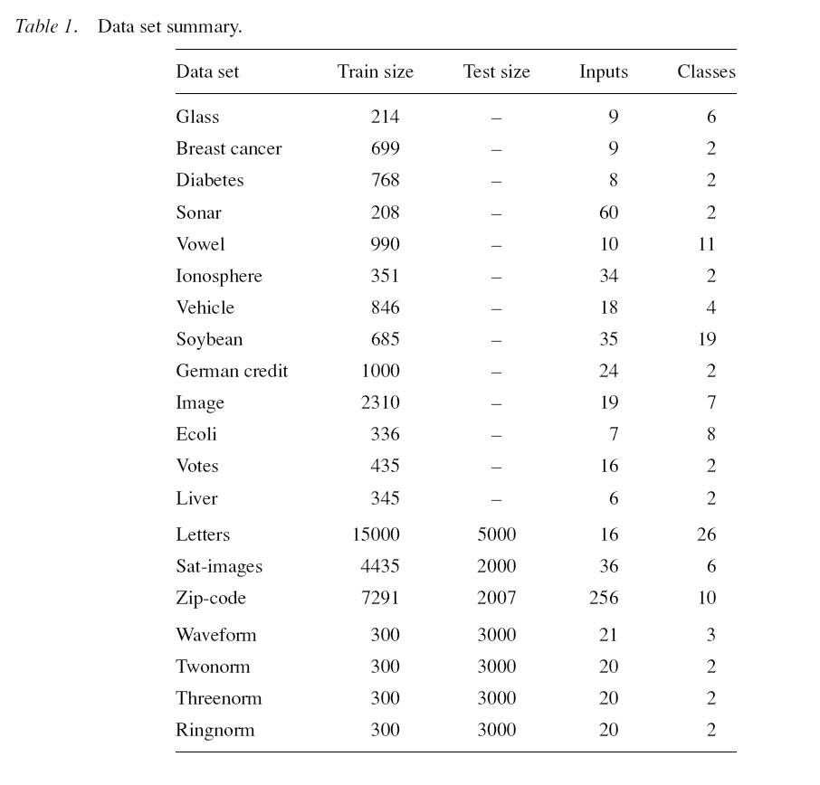
Experiments for Random Forests (Breiman, 2001)

Slide 57
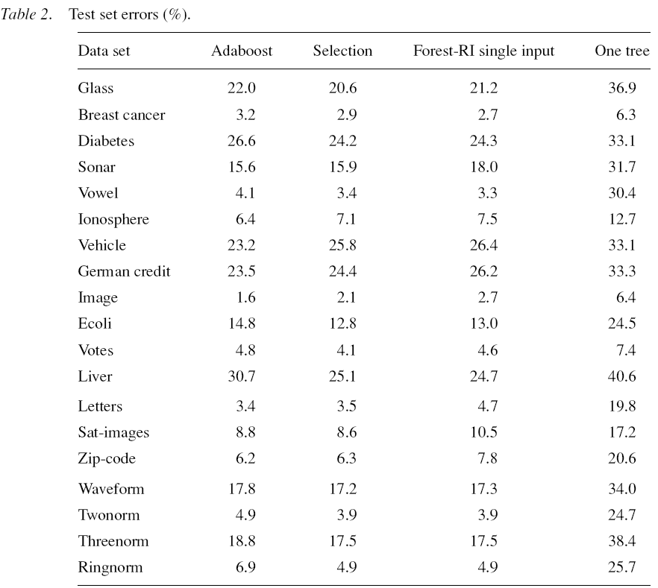

Slide 58
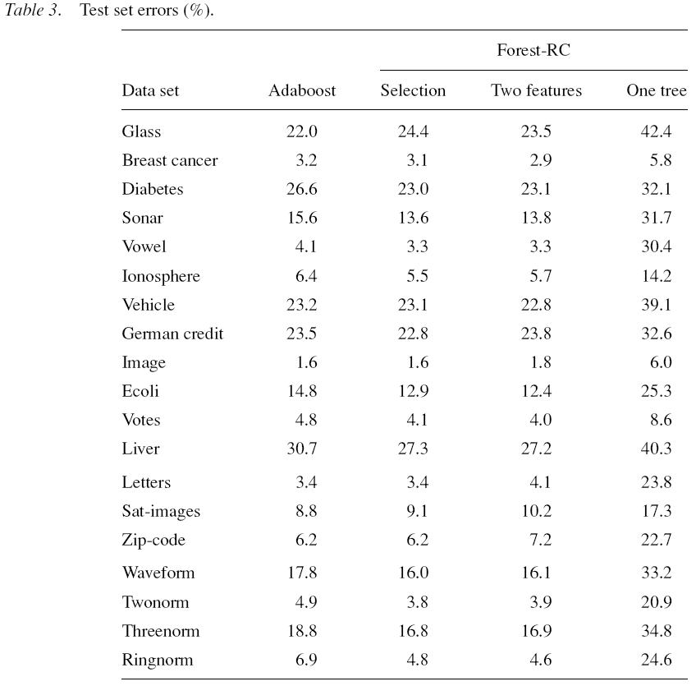

Slide 59
Comments on
Bagging, Boosting, Random Forests
Improving prediction accuracy and stability
Sacrificing the ease of interpretation
Requiring a lot of computing time

Slide 60
Improving Prediction Accuracy
Retaining the Ease of Interpretation

Slide 61
How?
Selecting correct split rules
Using linear or nonlinear combination splits rather than a single variable split
Using piecewise linear fitting rather than piecewise constant fitting

Slide 62
Example: Dataset on New Cars (Loh, 2008)

Slide 63
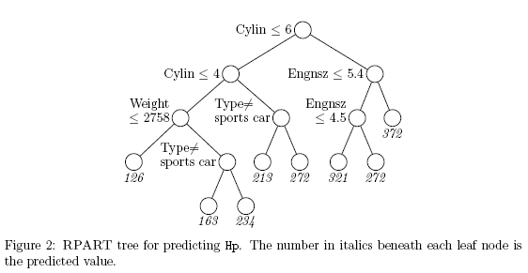
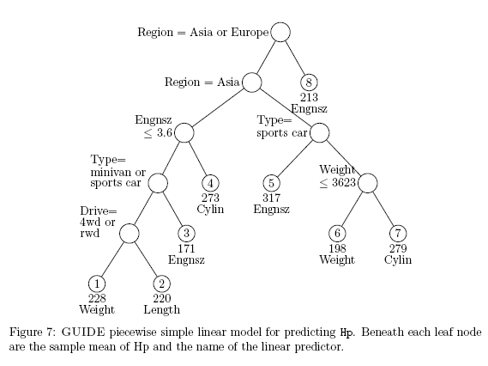

Slide 64
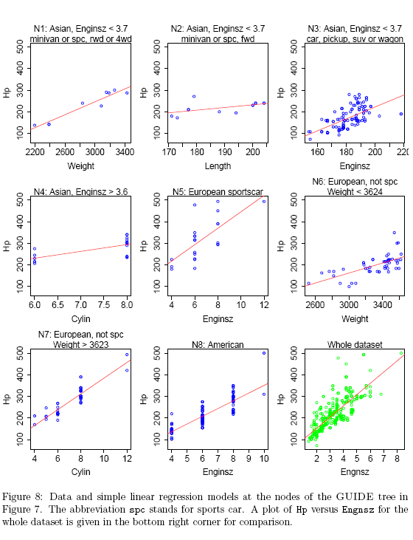

Slide 65
Diversifying Decision Trees

Slide 66
Decision Trees for Binary Data
Data: {(Y_{i}, X_{1i}, …, X_{pi}), i=,1,2,…,n}, where Y_{i}= 0 or 1
Algorithm/Software:
  Breiman et al., (1984) and Therneau and Atkinson (1997)/CART
  Quinlan (1993; 1996)/C4.5
  Loh and Shih (1997)/QUEST
  Chipman et al. (1998) and Dennison et al. (1998)/BART
  Kim and Loh (2001)/CRUISE
  Chan and Loh (2004)/LOTUS
  Hothorn et al. (2006) and Zeilis et al. (2008)/CTREE(MOB)
  Loh(2009)/GUIDE
  Rusch et al. (2013)/LORET
  and many others…

Slide 67
References for Continuous Data
Chan, K.-Y. and Loh, W.-Y. (2004). LOTUS: an algorithm for building accurate and comprehensible logistic regression trees, Journal of Computational and Graphical Statistics, 13:826-852.
Chaudhuri, P., Huang, M.-C., Loh, W.-Y., and Yao, R. (1994). Piecewise-polynomial regression trees, Statistica Sinica, 4:143-167.
Chaudhuri, P., Lo, W.-D., Loh, W.-Y., and Yang, C.-C. (1995). Generalized regression trees, Statistica Sinica, 5:641-666.
Chaudhuri, P. and Loh, W.-Y. (2002). Nonparametric estimation of conditional quantiles using quantile regression trees, Bernoulli,
Chipman, H., George, E. I. and McCulloch, R. E. (1998). Bayesian CART model search (with Discussion), Journal of the American Statistical Association, 93:935-948.
Denison, D. G. T., Mallick, B. K. and Smith, A. F. M. (1998). A Bayesian CART algorithm, Biometrika, 85:363-377.
Fan, G. and Gray, J. B. (2005). Regression tree analysis using TARGET, Journal of Computational and Graphical Statistics, 14:1-13.
Gama, J. (2004). Functional trees, Machine Learning, 55:219-250.
Hothorn, T., Horkik, K., and Zeileis, A. (2006). Unbiased recursive partitioning: a conditional inference framework, Journal of Computational and Graphical Statistics, 15:651-674.
Kim, H. and Loh, W.-Y. (2001). Classification trees with ubbiased multiway splits, Journal of the American Statistical Association, 96:598-604.
Loh, W.-Y. and Shih, Y.-S. (1997). Split selection methods for classification trees, Statistica Sinica, 7:815-840.
Loh, W.-Y. (2009). Improving the precision of classification trees, Annals of Applied Statistics, 3:1710-1737.
Quinlan, J. (1993). C4.5: programs for machine learning. Morgan Kaufmann Publishers.
Quinlan, J. (1996). Learning first-order definitions of functions. Journal of Artificial Intelligence Research, 5:139-161.
Rusch, T., Lee, I., Hornik, K., Jank, W. and Zeileis, A. (2013). Influencing elections with statistics: targeting voters with logistic regression trees, Annals of Applied Statistics, 7:1612-1639.
Zeilies, A., Hothorn, T. and Hornik, K. (2008). Model-based recursive partitioning, Journal of Computational and Graphical Statistics, 17:492-514.

Slide 68
Decision Trees for Continuous Data
Data: {(Y_{i}, X_{1i}, …, X_{pi}), i=,1,2,…,n}, where Y_{i}=continuous
Algorithm/Software:
  Breiman et al. (1984) and Therneau and Atkinson (1997)/CART
  Quinlan (1993; 1996)/M5
  Chaudhuri et al. (1994;1995; 2002)/SUPPORT
  Chipman et al. (1998; 2002; 2010)/BART
  Loh (2002) and Loh et al. (2007)/GUIDE
  Su et al. (2004)/MLRT
  Gama (2004)
  Fan and Gray (2005)/TARGET
  Hothorn et al. (2006) and Zeilis et al. (2008)/CTREE
  Pratola et al. (2013)/PBART
  and many others…

Slide 69
References for Continuous Data
Breiman, L., Freidman, J., Olshen, R. A. and Stone, C. J. (1984). Classification and Regression Trees. Monterey, Calif, Wadsworth, Inc.
Chaudhuri, P., Huang, M.-C., Loh, W.-Y., and Yao, R. (1994). Piecewise-polynomial regression trees, Statistica Sinica, 4:143-167.
Chaudhuri, P., Lo, W.-D., Loh, W.-Y., and Yang, C.-C. (1995). Generalized regression trees, Statistica Sinica, 5:641-666.
Chaudhuri, P. and Loh, W.-Y. (2002). Nonparametric estimation of conditional quantiles using quantile regression trees, Bernoulli,
Chipman, H., George, E. I. and McCulloch, R. E. (1998). Bayesian CART model search (with Discussion), Journal of the American Statistical Association, 93:935-948.
Chipman, H., George, E. I. and McCulloch, R. E. (2002). Bayesian treed model, Machine Learning, 48:299-320.
Chipman, H., George, E. I. and McCulloch, R. E. (2010). BART:Bayesian additive regression trees, Annals of Applied Statistics, 4:266-298.
Fan, G. and Gray, J. B. (2005). Regression tree analysis using TARGET, Journal of Computational and Graphical Statistics, 14:1-13.
Gama, J. (2004). Functional trees, Machine Learning, 55:219-250.
Hothorn, T., Horkik, K., and Zeileis, A. (2006). Unbiased recursive partitioning: a conditional inference framework, Journal of Computational and Graphical Statistics, 15:651-674.
Loh, W.-Y. (2002). Regression trees with unbiased variable selsection and interaction detection, Statistica Sinica, 12:361-386.
Loh, W.-Y., Chen, C.-W. and Zheng, W. (2007). Extrapolation errors in linear model trees, ACM Transactions on Knowledge Discovery from Data, 1(2):1-17.
Pratola, M. T., Chipman, H., Gattiker, J. R., Higdon, D. M., McCulloch, R. E. and Rust, W. N. (2013). Parallel Bayesian additive regression trees, Journal of Computational and Graphical Statistics, to appear.
Quinlan, J. (1992). Learning with continuous classes. Proceedings of the 5th Australian Joint Conference on Artificial Intelligence, Singapore: World Scientific.
Su, X., Wang, M., and Fan, J. (2004). Maximum likelihood regression trees, Journal of Computational and Graphical Statistics, 13:586-598.
Zeilies, A., Hothorn, T. and Hornik, K. (2008). Model-based recursive partitioning, Journal of Computational and Graphical Statistics, 17:492-514.

Slide 70
Decision Trees for Censored Data
Data: {(Y_{i},δ_{i}, X_{1i}, …, X_{pi}), i=,1,2,…,n}, where
Y_{i}=time-to-event, C_{i}=censoring time, and δ_{i}=min(Y_{i},C_{i})
Algorithm/Software:
  LeBlanc and Crowley (1993)/CART
  Ahn and Loh (1994)
  Therneau and Atkinson (1997)/RPART
  Mallick et al. (1999)/BART
  Fan et al. (2006)
  Hothorn et al. (2006)/CTREE
  Zeilies et al. (2008)/MOB
  Cho and Hong (2008)/STUDI
  Su et al. (2009)
  Bou-Hamad et al. (2009)
  Fan et al. (2009)
  Bertolet et al. (2012)
  Loh et al. (2013)/GUIDE
  and many others…

Slide 71
References for Censored Data
Ahn, H. and Loh, W.-Y. (1994). Tree-structured proportional hazards regression modeling, Biometrics, 50:471-485.
Bertolet, M. Brooks, M. M., and Bittner V. (2012). Tree-based identification of subgroups for time-varying covariate survival data, Statistical Methods in Medical Research, 1-14.
Bou-hamad, I., Larocque, D., Ben-ameur, H., Masse, L. C., Vitaro, F. and Tremblay, R. E. (2009). Discrete-time survival trees, The Canadian Journal of Statistics, 37:17-32.
Cho, H. and Hong, S.-M. (2008). Median regression tree for analysis of censored survival data, IEEE Transactions on Systems, Man, and Cybernetics-Part A, 38:715-716.
Fan, J., Su, X.-G., Levine, R. A., Nunn, M. E., and LeBlanc, M. (2006). Trees for correlated survival data by goodness of split, with applications to tooth prognosis, Journal of American Statistical Association, 101:959-967.
Fan, J., Nunn, M. E., and Su, X. (2009). Multivariate exponential survival trees and their application to tooth prognosis, 53:1110-1121.
Hothorn, T., Horkik, K., and Zeileis, A. (2006). Unbiased recursive partitioning: a conditional inference framework, Journal of Computational and Graphical Statistics, 15:651-674.
LeBlanc, M. and Crowley, J. (1993). Survival trees by goodness of split, Journal of the American Statistical Association, 88:457-467.
Loh, W.-Y., He, X., and Man, M. A. (2013). A regression tree approach to identifying subgroups with differential treatment effects, Manuscript.
Mallick, B. K., Denison, D. G. T. and Smith, A. F. M. (1999). Bayesian survival analysis using a MARS model, Biometrics, 55:1071-1077.
Su, X., Tsai, C.-L., Wang, H., Nickerson, D. M., Li, B. (2009). Subgroup analysis via recursive partitioning, Journal of Machine Learning Research, 10:141-158.
Zeileis, A., Hothorn, T. and Hornik, K. (2008). Model-based recursive partitioning, Journal of Computational and Graphical Statistics, 17:492-514.

Slide 72
Decision Trees for Count Data
Data: {(Y_{i}, X_{1i}, …, X_{pi}), i=,1,2,…,n}, where Y_{i}=counts
Algorithm/Software:
  Loh (2002)/GUIDE
  Lee and Jin (2006)
  Rusch et al. (2013)
  Lee (2014)

Slide 73
References for Count Data
Lee, S. H. (2014). Residual-based unbiased decision trees for over-dispersed and zero-inflated count data, Unpublished PhD dissertation, Korea University, Seoul.
Lee, S.-K. and Jin, S. (2006). Decision tree approaches for zero-inflated count data, Journal of Applied Statistics, 33:853-865.
Loh, W.-Y. (2002). Regression trees with unbiased variable selsection and interaction detection, Statistica Sinica, 12:361-386.
Rusch, T., Hormarcher, P., Hatzinger, R. and Hornik, K. (2013). Model trees with topic model preprocessing: an approach for data journalism illustrated with the wikileaks Afghanistan war logs, Annals of Applied Statistics, 7:613-639.

Slide 74
Decision Trees for Multivariate Binary Data
Data: {(Y_{1i}, …,Y_{qi}, X_{1i}, …, X_{pi}), i=,1,2,…,n},
where Y_{ji}=0 or 1
Algorithm/Software:
  Zhang (1998)/CTMBR
  Sicilano and Mola (2000)
  Noh et al. (2004)
  Lee (2005)
  Lee and Shih (2006)
  Piccarreta (2010)
  Moon (2010)

Slide 75
References for Multivariate Binary Data
Lee, S.-K. (2005). Using generalized estimating equations to learn decision trees with multivariate responses, Data Mining and Knowledge Discovery, 11:273-293.
Lee, T.-H. and Shih, Y.-Sh. (2006). Unbiased variable selection for classification trees with multivariate responses, Computational Statistics and Data Analysis, 51:659-667.
Noh, H. G. , Song, M. S., and Park, S. H. (2004). An unbbiased method for constructing multilable classification trees, Computational Statistics and Data Analysis, 47: 149-164.
Moon, H. (2010). Decision trees for repeated binary data, Unpublished PhD dissertation, Korea University, Seoul.
Piccarreta, R. (2010). Binary trees for dissimilarity data, Computational Statistics and Data Analysis, 54:1516-1524.
Siciliano, R. and Mola, F. (2000). Multivariate data analysis and modeling through classification and regression trees, Computational Statistics and Data Analysis, 32:285-301.
Zhang, H. (1998). Classification trees for multiple binary responses, Journal of the American Statistical Association, 93: 180-193.

Slide 76
Decision Trees for Multivariate Ordinal Data
Data: {(Y_{1i}, …,Y_{qi}, X_{1i}, …, X_{pi}), i=,1,2,…,n},
where Y_{ji}= 1,2, …
Algorithm/Software:
  Lee (2006)
  Zhang and Ye (2008)/CTMBR
  Kung et al. (2012)
  Strobl et al. (2013)

Slide 77
References for Multivariate Ordinal Data
Kung, Y.-H., Lin, C.-T., Shih, Y.-Sh. (2012). Split variable selection for tree modeling on rank data, Computational Statistics and Data Analysis, 56:2830-2836.
Lee, S. K. (2006). On classification and regression trees for multiple responses and its application, Journal of Classification, 23:123-141.
Noh, H. G. , Song, M. S., and Park, S. H. (2004). An unbiased method for constructing multilable classification trees, Computational Statistics and Data Analysis, 47: 149-164.
Strobl, C. , Kopf, J. and Zeileis, A. (2013). Rasch trees: a new method for detecting differential item functioning in the rasch model, To appear in Psychometrika.
Zhang, H. and Ye, Y. (2008), A tree-based model for modeling a multivariate ordinal response, Statistics and its Interface, 1:169-178.

Slide 78
Decision Trees for Longitudinal Data
Data: {(Y_{1i}, …,Y_{Ti}, X_{1i}, …, X_{pi}), i=,1,2,…,n}, where Y_{ti}=continuous measurements repeated over time
Algorithm/Software:
  Gillo and Shelly (1974)
  Segal (1992) and De’ath (2002)/MVPART
  Yu and Lambert (1999)
  Siciliano and Mola (2000)
  Hsiao and Shih (2007)
  Hajjem, Bellavance and Laroque (2011)
  Sela and Simonoff (2012) and Simonoff (2013)/REEMtree
  Loh and Zheng (2013)/GUIDE
  Eo and Cho (2013)/MELT
  Kundu and Harezlak (2013)

Slide 79
References for Longitudinal Data
De’ath, G. (2002). Multivariate regression trees: a new technique for modeling species-environment relationships, Ecology, 83: 1105-1117.
Gillo, M.W. and Shelly, M.W. (1974). Predictive modeling of multivariable and multivariate data, Journal of the American Statistical Association, 69: 646-653.
Hajjem, A., Bellavance, F. and Larocque, D. (2011). Mixed effects regression trees for clustered data, Statistics and Probability Letters, 81:451-459.
Hsiao, W.-C. and Shih, Y.-S. (2007). Splitting variable selection for multivariate regression trees, Statistics and Probability Letters, 77:265-271.
Kundu, M.G. and Harezlak, J. (2013). Regression trees for longitudinal data. arXiv,1309.7733.
Loh, W.-Y. and Zheng W. (2013). Regression trees for longitudinal and multiresponse data, The Annals of Applied Statistics, 7:495-522.
Segal, M. R. (1992). Tree-structured methods for longitudinal data, Journal of the American Statistical Association, 87:407-418.
Sela, R. J. and Simonoff, J. S. (2012). RE-RM trees: a data mining approach for longitudinal and clustered data, Machine Learning, 86: 169-207.
Siciliano, R. and Mola, F. (2000). Multivariate data analysis and modeling through classification and regression trees, Computational Statistics and Data Analysis, 32:285-301.
Simonoff, J. S. (2013). Regression tree-based diagnostics for linear multilevel models, Statistical Modelling, 13: 459-480.
Yu, Y. and Lambert, D. (1999). Fitting trees to functional data, with an application to time-of-day patterns, Journal of Computational and Graphical Statistics, 8: 749-762.

Slide 80
Decision Trees for Mixed Response Data
Data: {(Y_{1i},Y_{2i}, X_{1i}, …, X_{pi}), i=,1,2,…,n},
where Y_{1i} =binary,Y_{2i}=continuous
Algorithm/Software:
  Dine(2009)

Slide 81
References for Mixed Response Data
De’ath, G. (2002). Multivariate regression trees: a new technique for modeling species-environment relationships, Ecology, 83: 1105-1117.

